Slide 1


Outsourcing of Production
Presented by: Azaali Jetha, Leanne Johnston, Matthew Kozlowski & Dustin Daub
Notes:
Hello, my name is Azaali and I am joined today by Leanne, Matthew and Dustin. In today’s presentation we will be discussing the outsourcing of production in relation to organizations.

Slide 2

Introduction
What is outsourcing of production?
Review the statistics of past and current firms
Explore expert business and case study opinions
Focus on the facts showing the benefits of outsourcing
This Photo by Unknown Author is licensed under CC BY-SA-NC

Slide 3
Team Thesis
By utilizing outsourcing, an organization can improve its strategic position by reducing costs, driving innovation, and focusing on core competencies

Slide 4
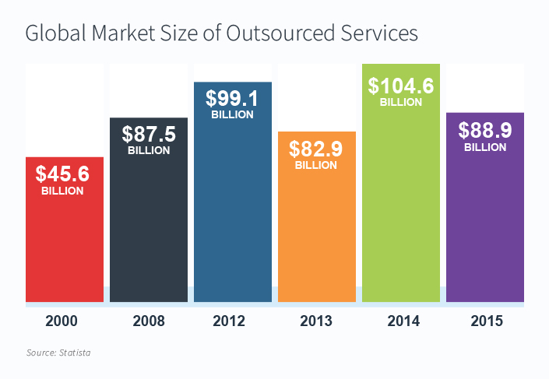
Statistics
Global market worth over $80 billion (Vojinovik, 2020)
In the US, 59% of businesses use outsourcing (Vojinovik, 2020)
Main reason to outsource is to cut costs
https://www.microsourcing.com/learn/blog/the-ultimate-list-of-outsourcing-statistics/

Slide 5
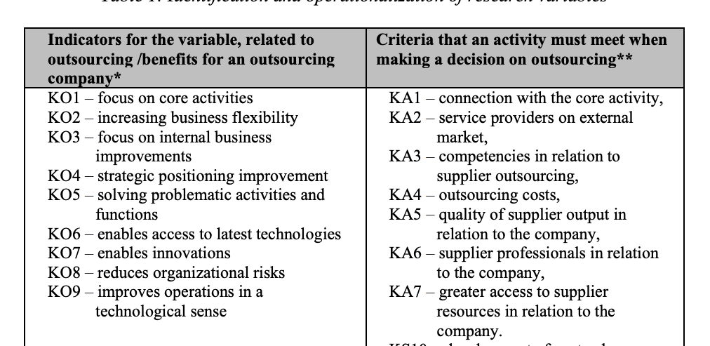
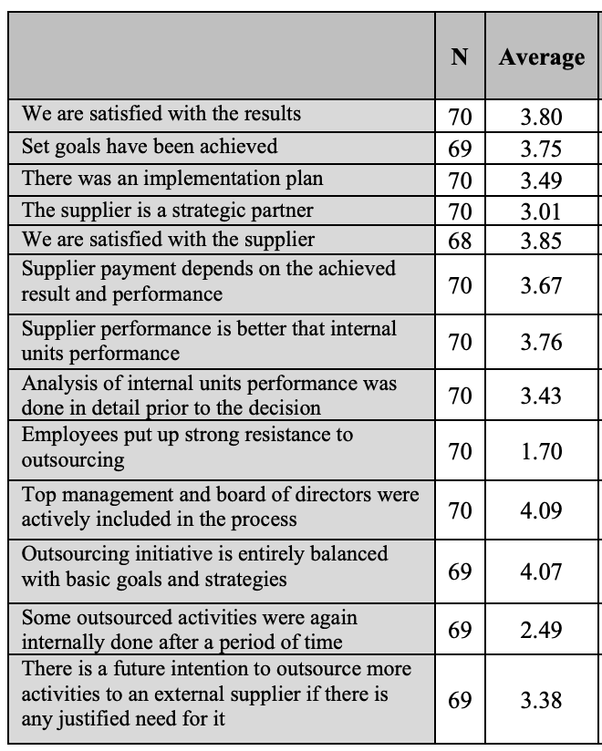
Expert Opinion
Table 1: Identification and operationalization of research variables
Dr. Maja Leticia, Assistant Professor from Faculty of Economics, University of Mostar

Slide 6
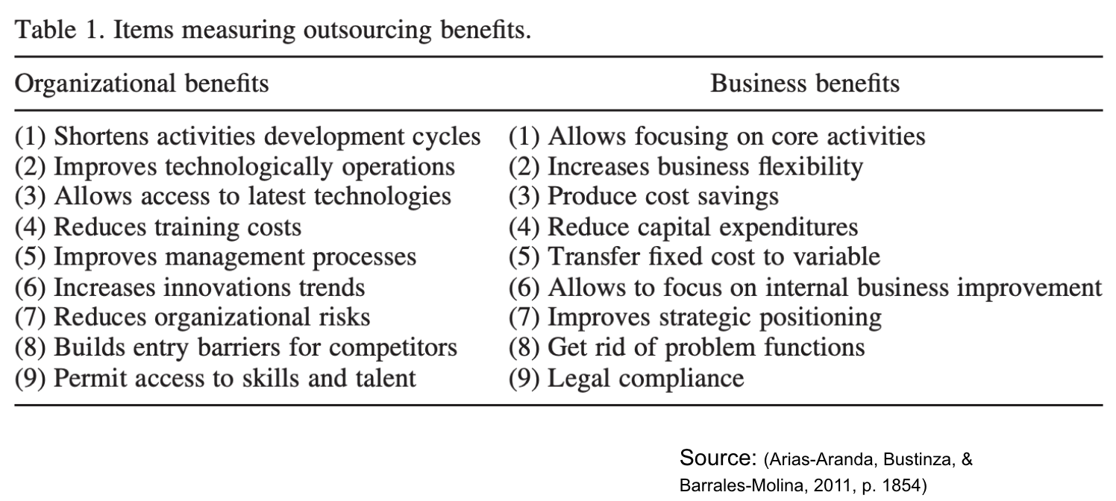
Organization & Business Benefits of Outsourcing

Slide 7



Innovation
Critical to success in the business world
Outsourcing can positively drive innovation in a company
Healthcare Provider= Improved Claim Adjudication Process
Aerospace Manufacturer= Operation Efficiencies
Supermarket= Improved Supply Chain Management

Slide 8



Core Competencies
Firms must take action to ensure competitiveness
Improve competitive advantage through core competencies
Firm resources to be reallocated to reinforce strengths
Frees up human capital that can be shifted to other areas
Redundant capital assets to be sold and the resultant cash flow can be redirected to areas of strength

Slide 9

Cost Reduction
Firms can be more profitable through cost reduction
Outsourcing can provide cost reductions through various areas
  Improved efficiencies
  Outside expertise
  Reduced wage expense
Induces supplier competition, reduce subunits, eliminate transfer pricing issues
Cost reductions= Improve firm’s competitive advantage
This Photo by Unknown Author is licensed under CC BY-SA-NC

Slide 10
Cultural Benefits
When working abroad
Different thinking
Hiring better talent

Slide 11

Government Support
Trade Agreements
Tariff Structure supports trade
Outsourcing keeps costs low for taxpayers
Promoting foreign investment
Countries with few resources and many workers rely on outsourcing
Increased quality of life in manufacturing countries

Slide 12

Conclusion
Expertise
Innovation
Focused Capital Funding
Government Support
Regional Growth
Reduced Manufacturing Costs
https://www.insperity.com/blog/how-to-outsource/

Slide 13
References
Arias-Aranda, D., Bustinza, O. F., & Barrales-Molina, V. (2011, August). Operations flexibility and outsourcing benefits: an empirical study in service firms. The Service Industries Journal, 31(11), 1849-1870. Retrieved from http://libezproxy.nait.ca/login?url=http://search.ebscohost.com/login.aspx?direct=true&db=bth&AN=62666654&site=ehost-live&scope=site
Canada, G. (2020, September 02). Canada-United States-Mexico Agreement (CUSMA). Retrieved October 31, 2020, from https://www.international.gc.ca/trade-commerce/trade-agreements-accords-commerciaux/agr-acc/cusma-aceum/index.aspx?lang=eng
Dekkers, R. (2000). Decision models for outsourcing and core competencies in manufacturing. International journal of production research, 4085-4096. Retrieved from https://nait.primo.exlibrisgroup.com/discovery/fulldisplay?docid=cdi_crossref_primary_10_1080_00207540050204948&context=PC&vid=01NOALTECH_INST:01NOALTECH&lang=en&search_scope=MyInst_and_CI&adaptor=Primo%20Central&tab=OneTab&query=any,contains,Decision%20M
Dolgui, A., & Proth, J.-M. (2013). Outsourcing: definitions and analysis. International Journal of Production Research, 6769-6777. Retrieved from https://nait.primo.exlibrisgroup.com/discovery/fulldisplay?docid=cdi_hal_primary_oai_HAL_emse_00881209v1&context=PC&vid=01NOALTECH_INST:01NOALTECH&lang=en&search_scope=MyInst_and_CI&adaptor=Primo%20Central&tab=OneTab&query=any,contains,Dolgui%20and%20Prot
European Commission Directorate-General for Trade. (2020, October 12). Retrieved October 31, 2020, from https://ec.europa.eu/trade/policy/countries-and-regions/negotiations-and-agreements/
Feenstra, R. C., & Hanson, G. H. (1996, January). Globalization, Outsourcing, and Wage Inequality. National Bureau of Economic Research, 5424. Retrieved from https://www.nber.org/system/files/working_papers/w5424/w5424.pdf
Gomez, C. (2018, August 15). How Outsourcing and the Culture Gap Can Produce Better Software. HR Technologist. Retrieved October 31, 2020, from https://www.hrtechnologist.com/articles/diversity/how-outsourcing-and-the-culture-gap-can-produce-better-software/
Hill, C. W., Hult, G. T., & McKaig, T. (2018). Global Business Today. Whitby, ON: McGraw Hill Ryerson Limited.
Lacity, M. C., & Willcocks, L. P. (2013, March 19). Outsourcing Business Processes for Innovation. MIT Sloan Management Review. Retrieved from https://sloanreview.mit.edu/article/outsourcing-business-processes-for-innovation/
Letica, M. (2016). The Effect of Outsourcing Activities Selection on the Benefits of Outsourcing. Management: Journal of Contemporary Management Issues, 21(2), 77–97. Retrieved from: http://libezproxy.nait.ca/login?url=http://search.ebscohost.com/login.aspx?direct=true&db=bth&AN=120389515&site=ehost-live&scope=site
Purcell, W. (2019, October 31). The importance of innovation in business. Retrieved from Northeastern University: https://www.northeastern.edu/graduate/blog/importance-of-innovation/
Vojinovik, I. (2020, August 13). 20 Outsourcing Statistics to Guide Your HR Decisions. Retrieved from https://www.smallbizgenius.net/by-the-numbers/outsourcing-statistics/#gref

